Slide 1
OLAP Data Analysis and Cleaning
Kurt Montanaro Institute of Information & Communication Technology University College MCAST, Paola PLA 9032 kurt.montanaro.a100362@mcast.edu.mt

Slide 2

Introduction
Nowadays, data plays a really important role in one’s daily activities.
This is continuously being acquired through various research methods such as empirical research, better known as direct observation by the acquirer, or the most common method used nowadays known as data mining.
This data is then stored as raw data in large data warehouses to be used for multiple purposes.
With the aid of Business Intelligence, this data could be further on monitored, analyzed , predicted and cleaned.

Slide 3
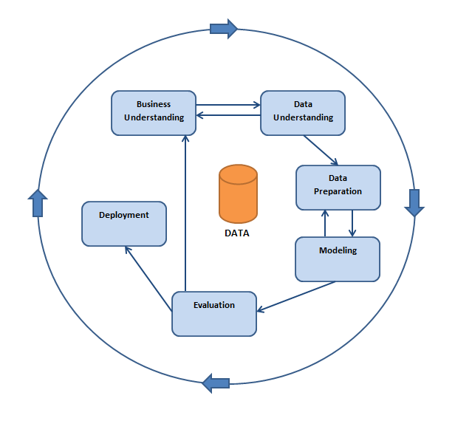
CRISP-DM
The Data Mining project was implemented based on the CRISP-DM methodology.
CRISP-DM deﬁnes a structured plan of events that have to take place before starting off with the actual Mining and analyses project.

Slide 4
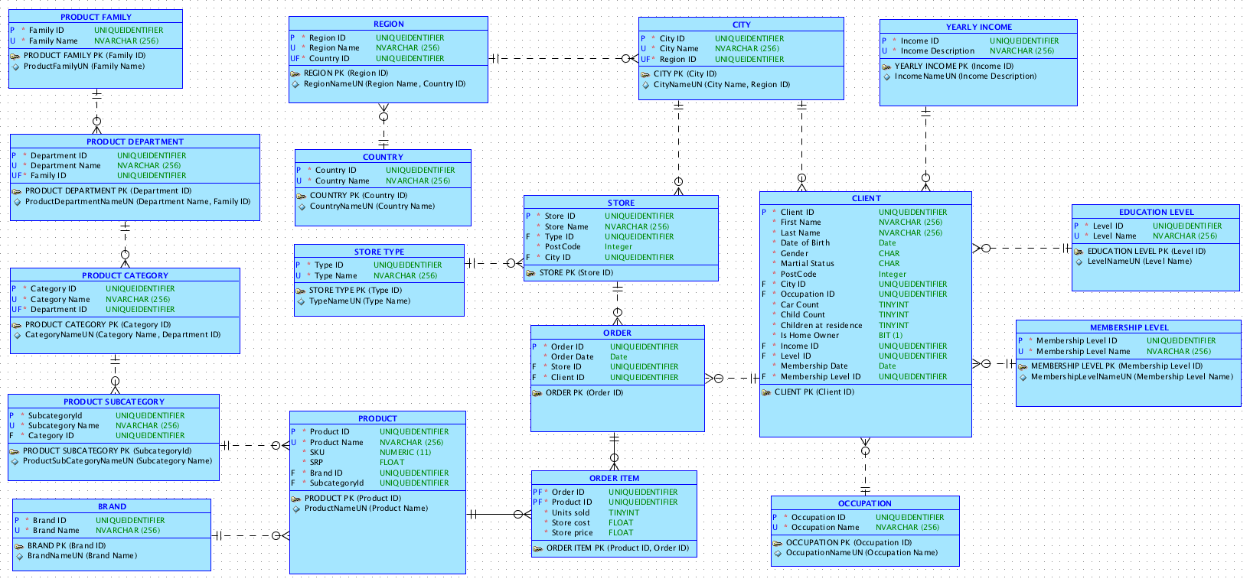
OLTP - Data Understanding
This stage allows me to access the initial data and familiarize myself with it, as to identify quality problems, which are of an issue when it comes to large amounts of data, set an insight to the data and detect on which sub set I can form a hypothesis on for any possible hidden outcomes.

Slide 5
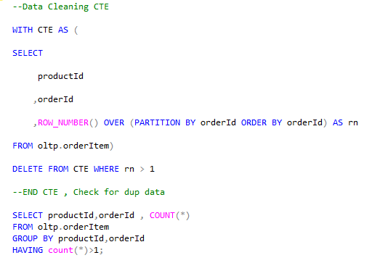
Data Cleaning
Prior to the model design itself, the data was cleaned from any redundant or duplicate data which would interfere the process later on.
With the use of a CTE, a temporary table was created as to partition data with a composite key which is present more than once in the OLTP data, and remove these in the process.
By doing this, I have eliminated redundancy of data which would interfere with the deployment phase

Slide 6
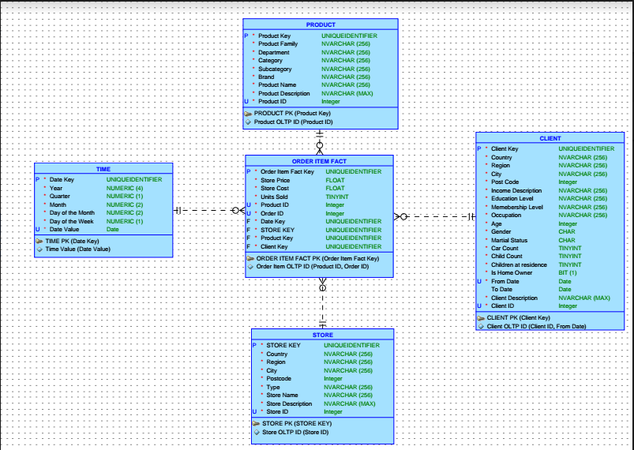
OLAP ERD
The view of the given data set is much more simpliﬁed and readable, portraying the Order Item as the fact table in the OLAP cube designed, along with the Client, Product and Store dimensions.
In this scenario one might notice that the Slowly Changing Dimension in the OLAP design is the Client dimension, by portraying From Date and To Date attributes as to keep track of the efﬁctive date in the data.

Slide 7
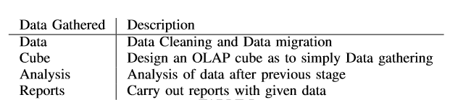
Data Gathered
After the required tables and procedures were coded and implemented, an ETL has been implemented as to migrate data in the newly structured tables.
The procedure in question handled client registration by means of a cursor. It can be a common mistake that if the ETL is not structured properly, the data may either not be migrated or transferred incorrectly, therefore it was made sure that each table was executed in its order, leaving the fact table the last one as it contains constraints and foreign keys.
Once the ETL proved successful and all OLAP dimensions were populated accordingly, reports were carried out on the dimensions by means of OLAP Operations which are Slice, Dice, Drill-down and Roll-up reports

Slide 8
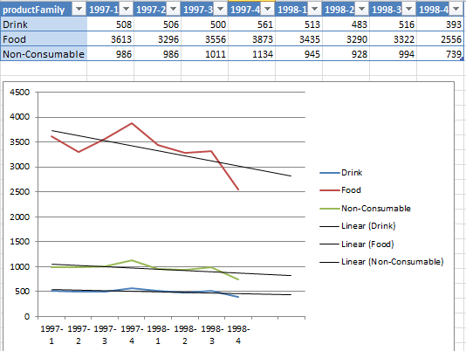
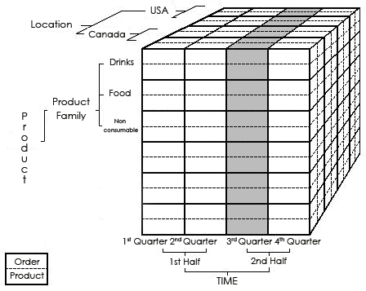
Data Analysis
After the Data Gathering stage was successfully executed, I have managed to output fruitful reports with data that is readable and adequate for formulations in order to determine any research outcomes.

Slide 9
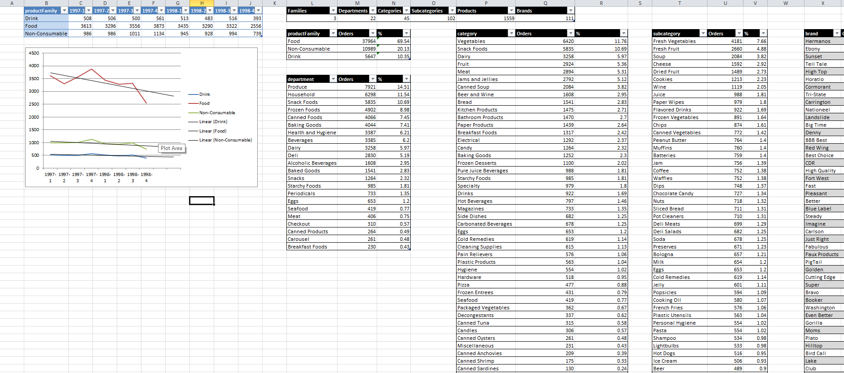
Data Reporting and Analysis CONT..
In terms of forecast all families were predicted for a downfall in the upcoming two quarters.This is clearly illustrated in one of the reports as illustrated in the above figure. All this is based on one country, that being USA. With further reports I have seen that as for most popular orders were for products which were Produce (Department), of Category Vegetables’, subcategory ’Fresh Vegetables’ and most popular brand being ’Hermanos’.
In further detail this was also reported by means of a pivot where both years in question were segmented in quarters by means of the time dimension, showing amount of orders of each family per period stated. With ’Food’ being the highest and ’Drink’ being the lowest, it was still fascinating enough to see that the ’Food’ family had a much more steep down fall towards the last quarter that that of the drinks sector.
First attribute to be reported was the product family against amount of orders, showing a signiﬁcant gap between the Family ’Food’ with the second in amount, being ’Non Consumable’.

Slide 10
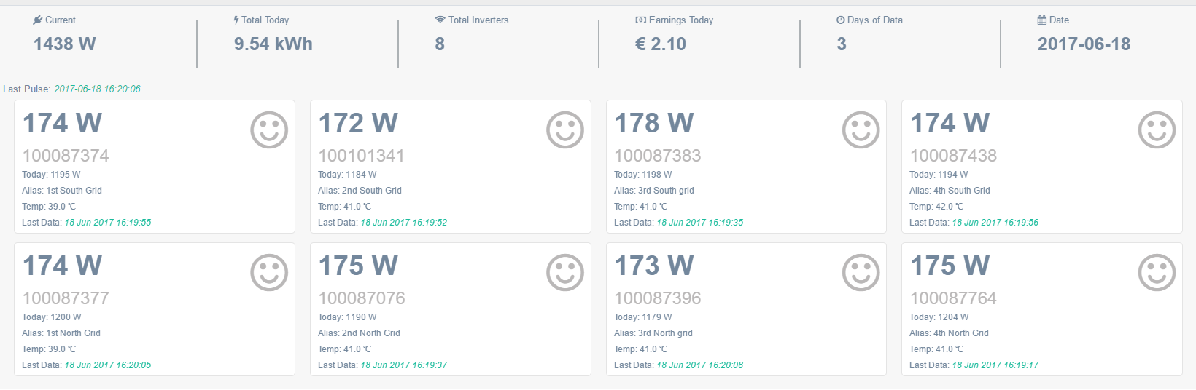
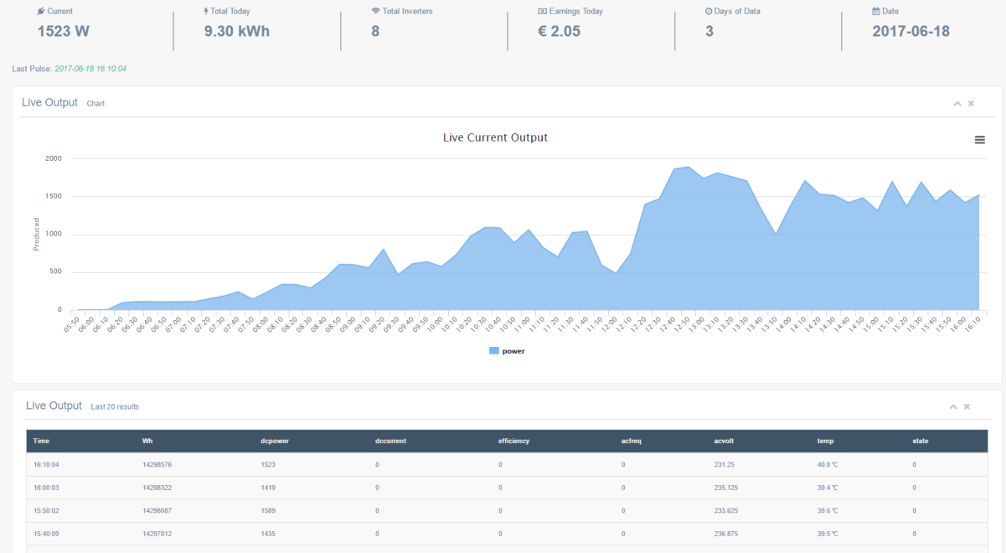
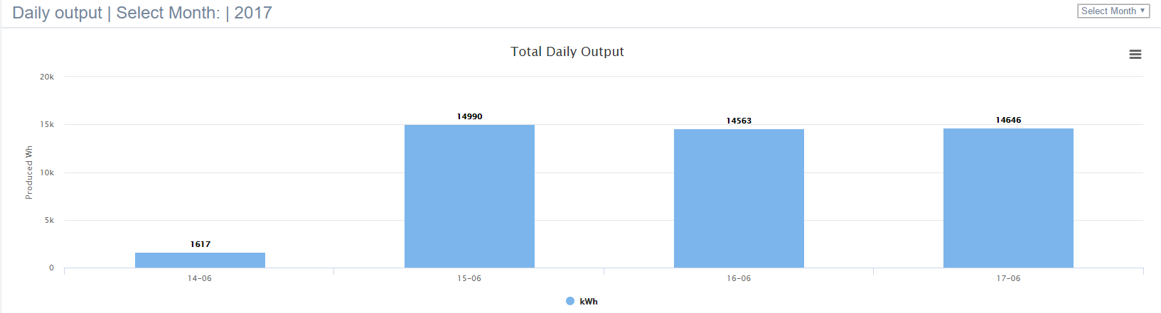
Future Works
Inspired by this project together with the original Solar panel gateway client, I managed to scrape data from our Solar Panels grid in order to monitor efficiency, health and forecast of power output.

Slide 11
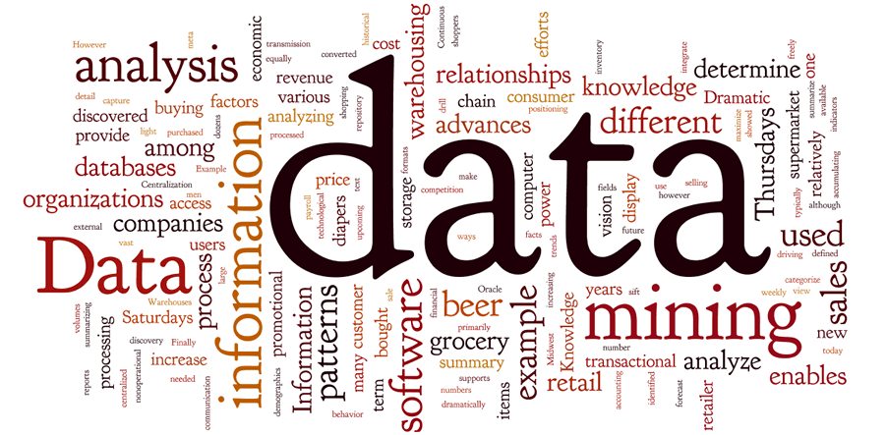
Conclusion
I would suggest using CRISP-DM for any future Data Mining projects, modelling data in OLAP cubes for easier understanding of data as these two factors allow access to most data warehouses, even if the data is near impossible to interpret from OLTP. This research will serve as a basis for further projects I will carryout on recent matters which are evolving in Malta.
Thanks for your time!

